Slide 1
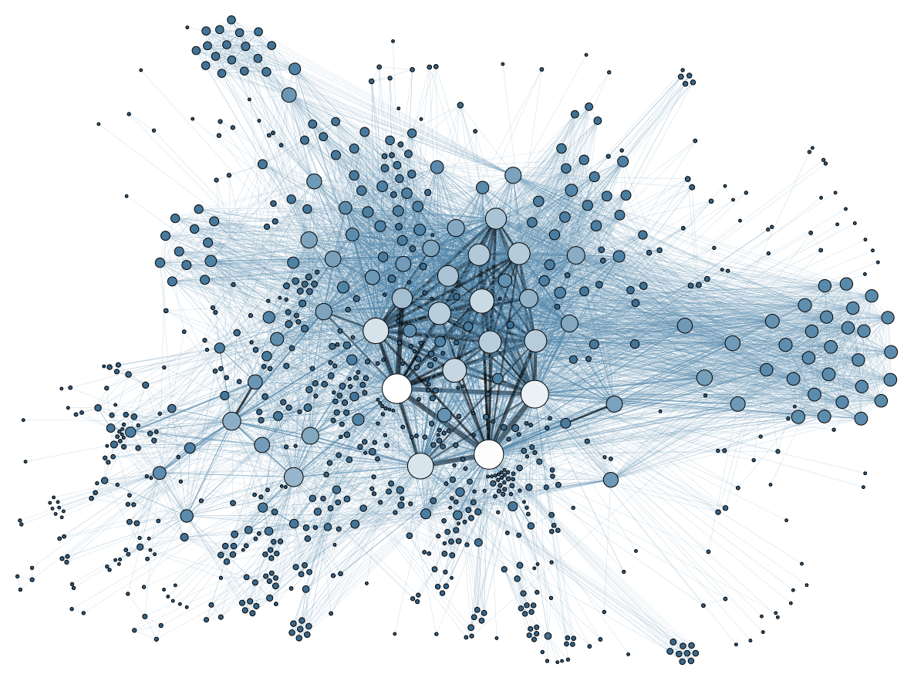
What launched the Big Data era?
Notes:
What launched the big data era?
In this video, you will learn about two new opportunities that have contributed to the launch of the big data era.
Opportunities are often a signal of changing times.
In 2013, an influential report by a company called McKinsey claimed that the area of data science will be the number one catalyst for economic growth.
McKinsey identified one of our new opportunities that contributed to the launch of the big data era. A growing torrent of data. This refers to the idea that data seems to be coming continuously and at a fast rate.
Think about this, today you can buy a hard drive to store all the music in the world for only $600.
That's an amazing storage capability over any previous forms of music storage. In 2010 there were 5 billion mobile phones in use. You can be sure that there are more today and as I'm sure you will understand, these phones and the apps we install on them are a big source of big data, which all the time, every day, contributes to our core. And Facebook, which recently just set a record of having one billion people login in a single day, has more that 30 billion pieces of content shared every month.
Well, that number's from 2013. So I'm sure that it's much higher than that now.
Does it make you think how many Facebook share's you made last month?
All this leads to projections of serious growth. 40% in global data per year, and 5% in global IT spending. This much data has sure pushed the data science field to start remaining itself and the business world of today.
But, there's something else contributing to the catalyzing power of data science. It is called cloud computing. We call this on demand computing. Cloud computing is one of the ways in which computing has now become something that we ca do anytime, and anywhere. You may be surprised to know that some of your favorite apps are from businesses being run from coffee shops. This new ability, combined with our torrent of data, gives us the opportunity to perform novel, dynamic and scalable data analysis, to tell us new things about our world and ourself. To summarize, a new torrent of big data combined with computing capability anytime, anywhere has been at the core of the launch of the big data era.

Slide 2
After this part you will be able to..
Describe how the combination of a growing torrent of data and on-demand (e.g. cloud) computing has launched the data science field

Slide 3
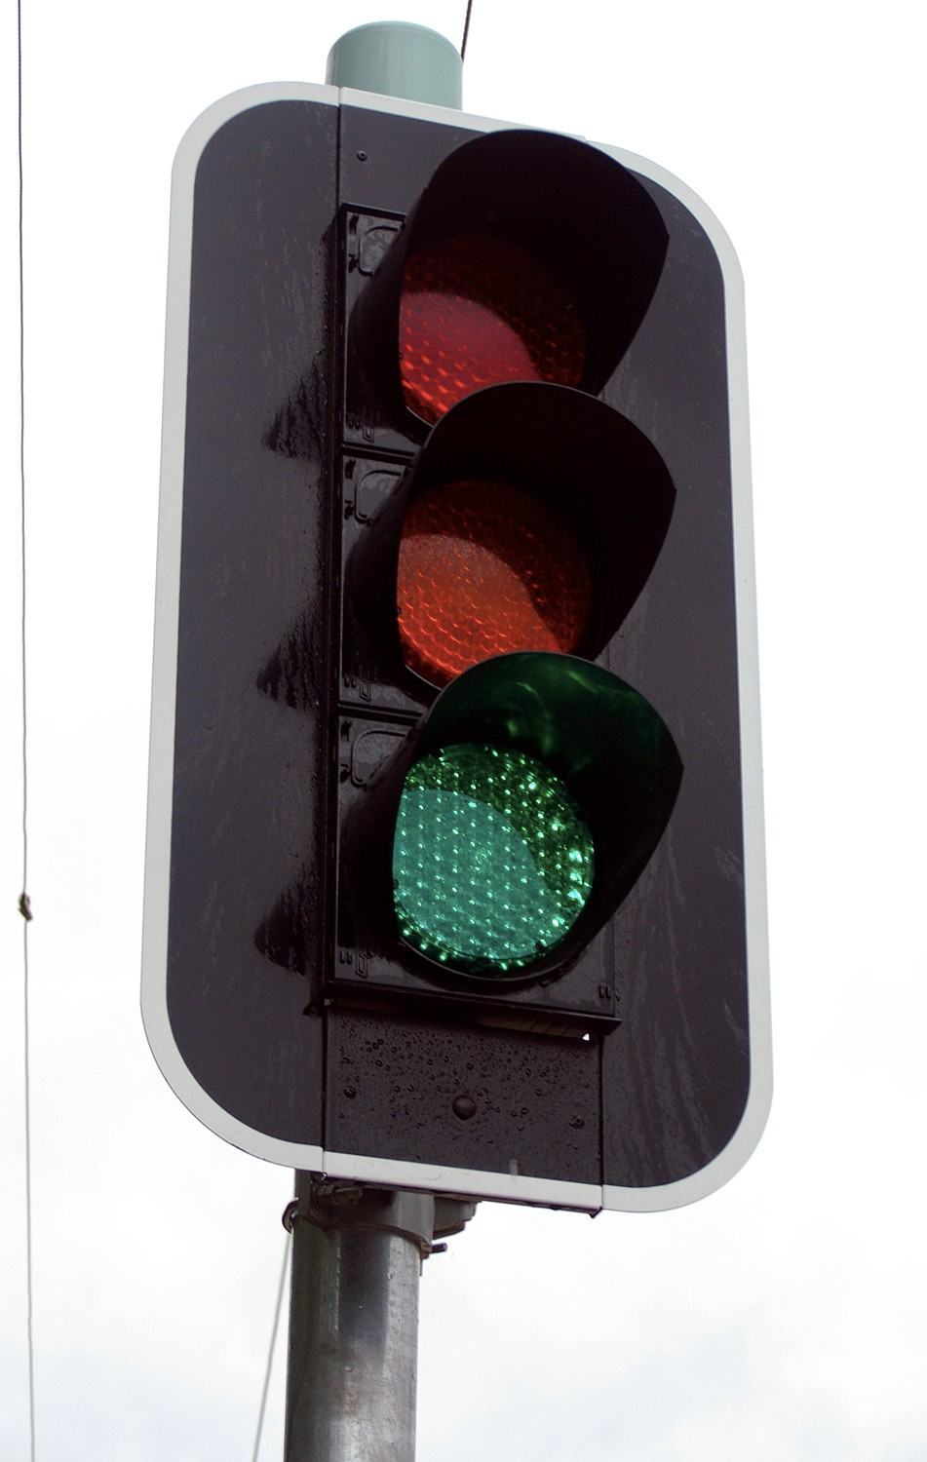
New Opportunities
Changing Times

Slide 4
Data Science →→
New Opportunities
#1 Catalyst for economic growth!
-McKinsey
Changing Times

Slide 5

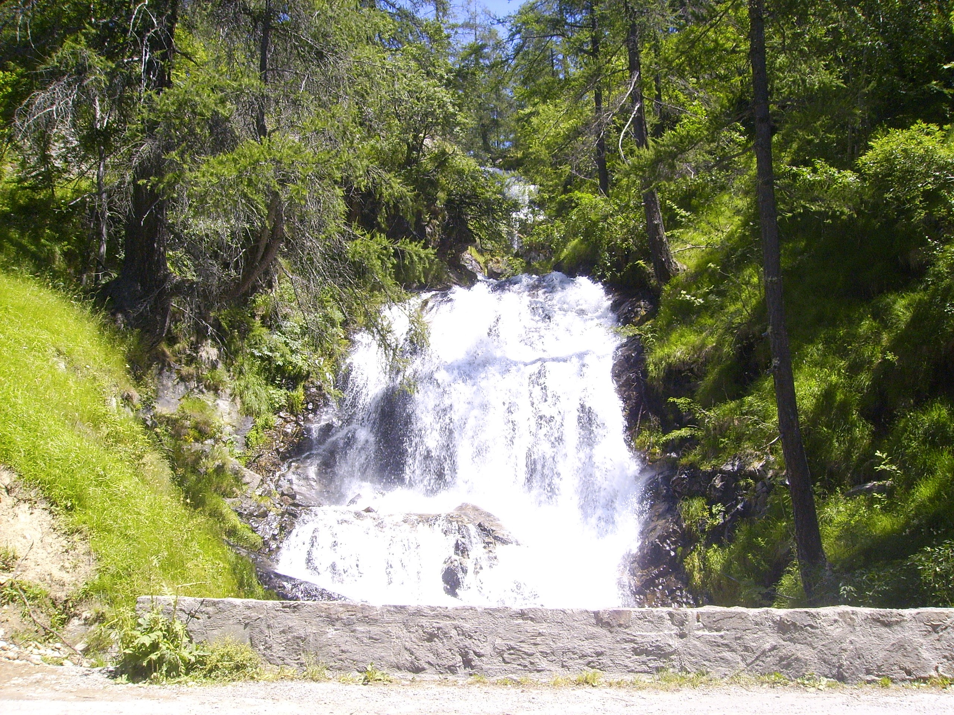
McKinsey Report (2013)

Slide 6
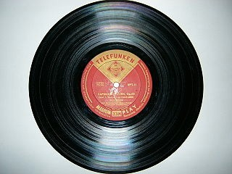
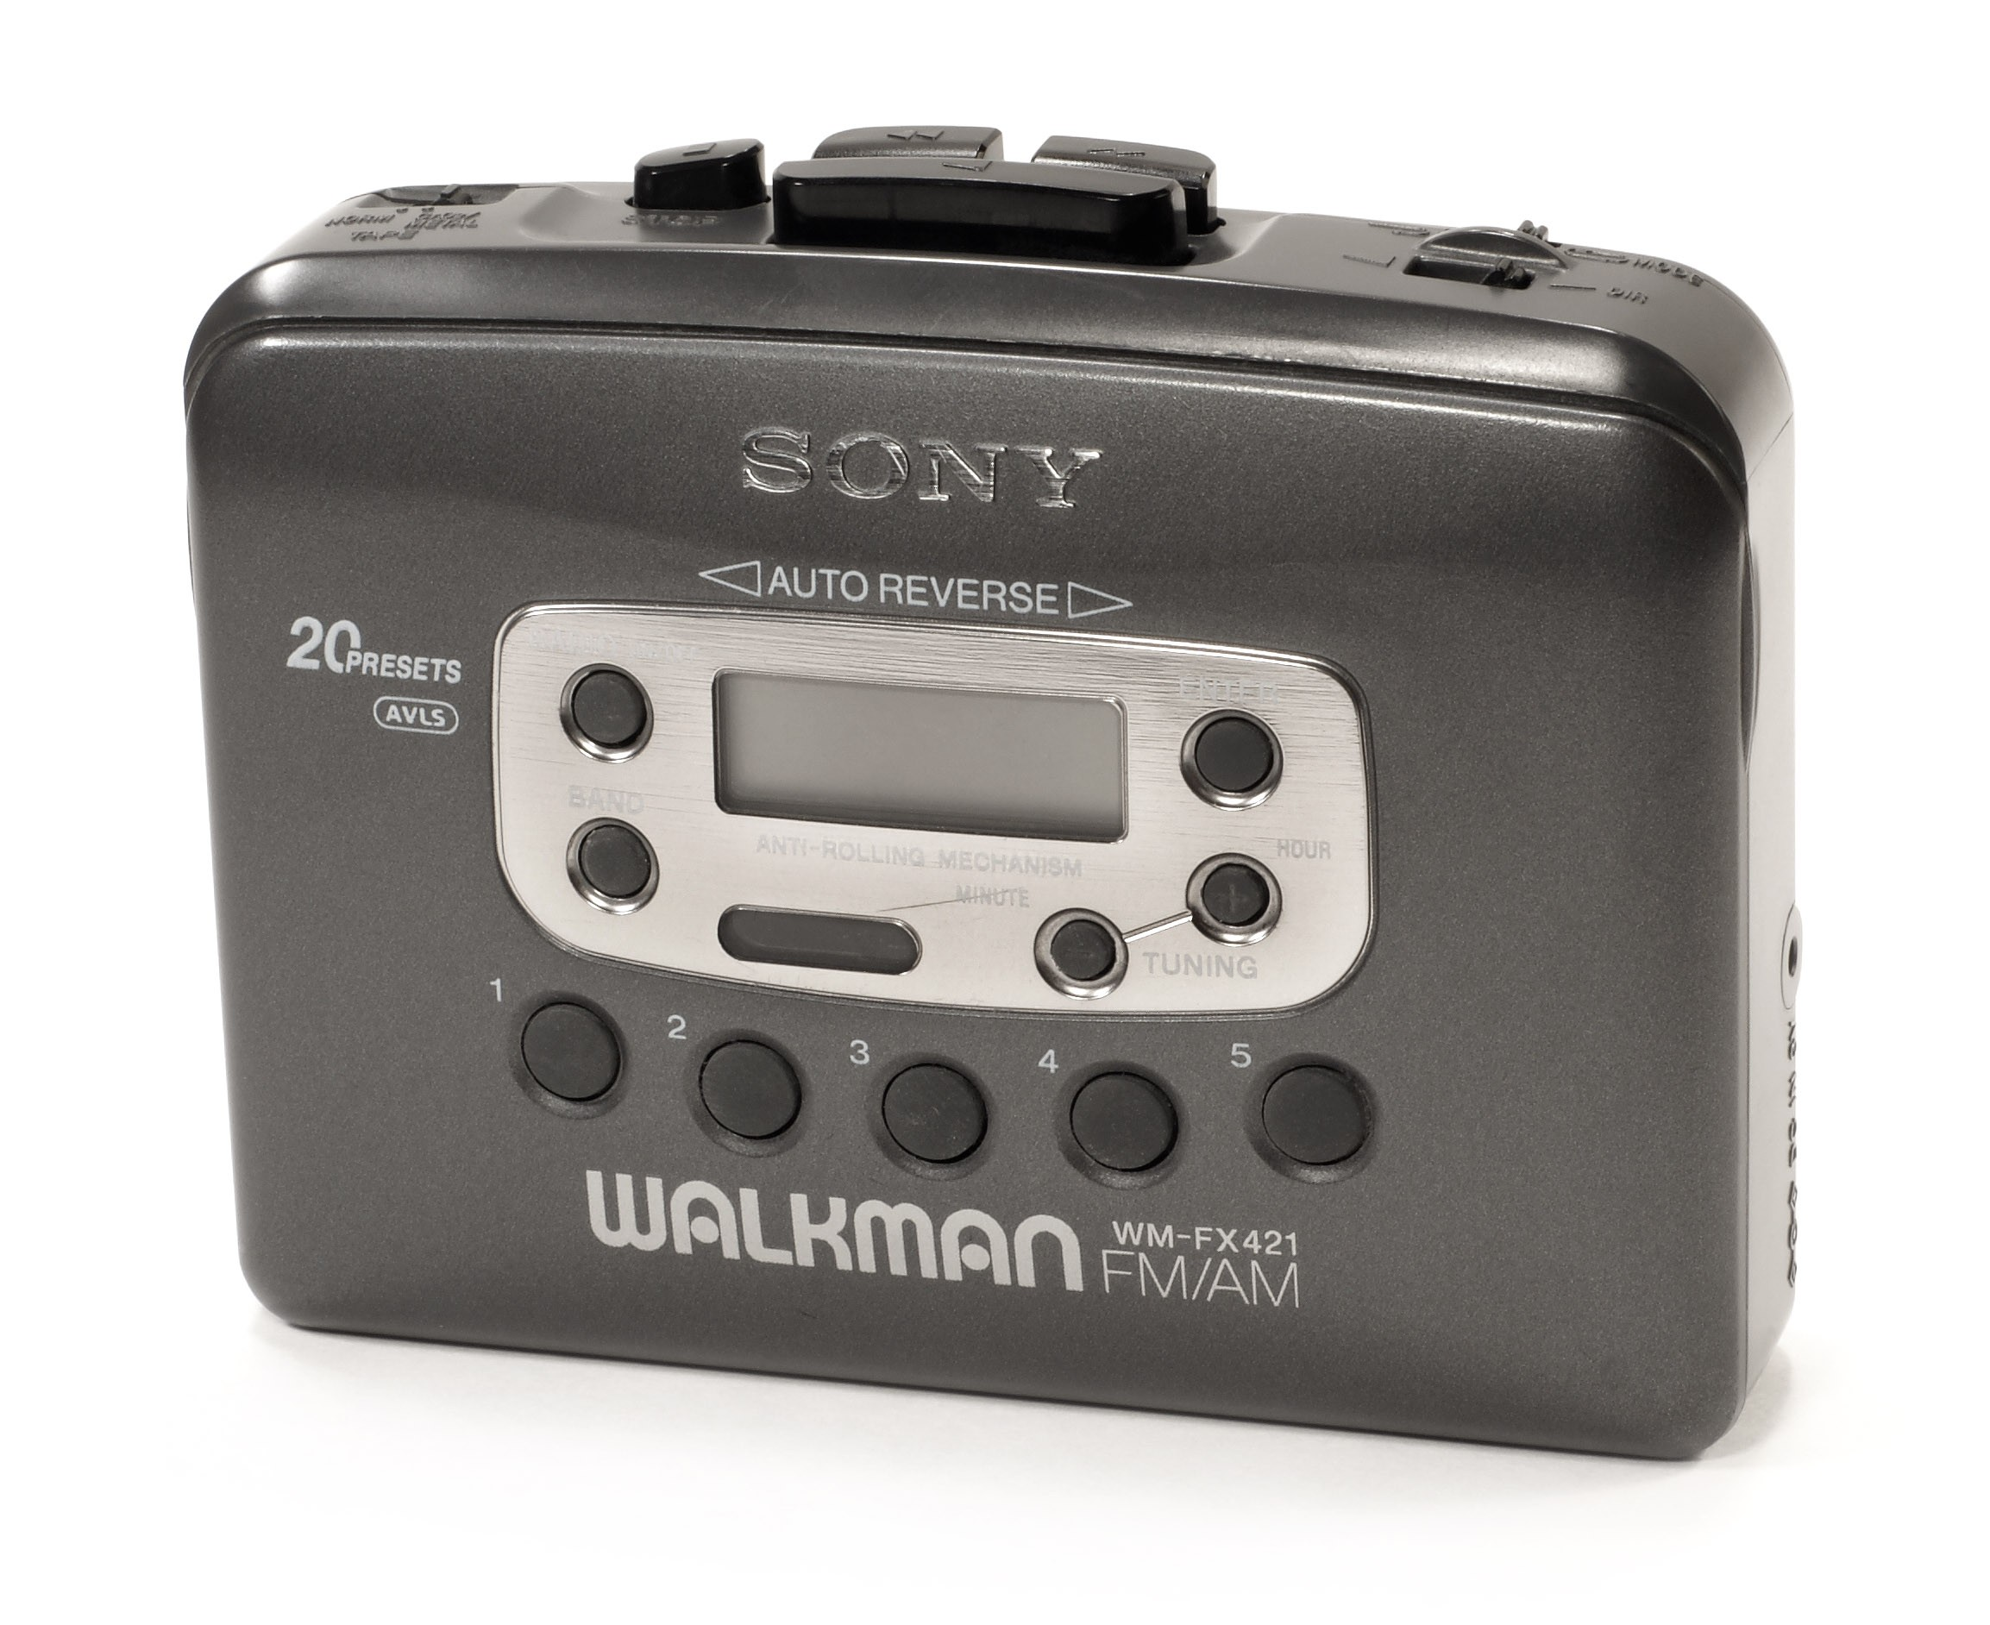
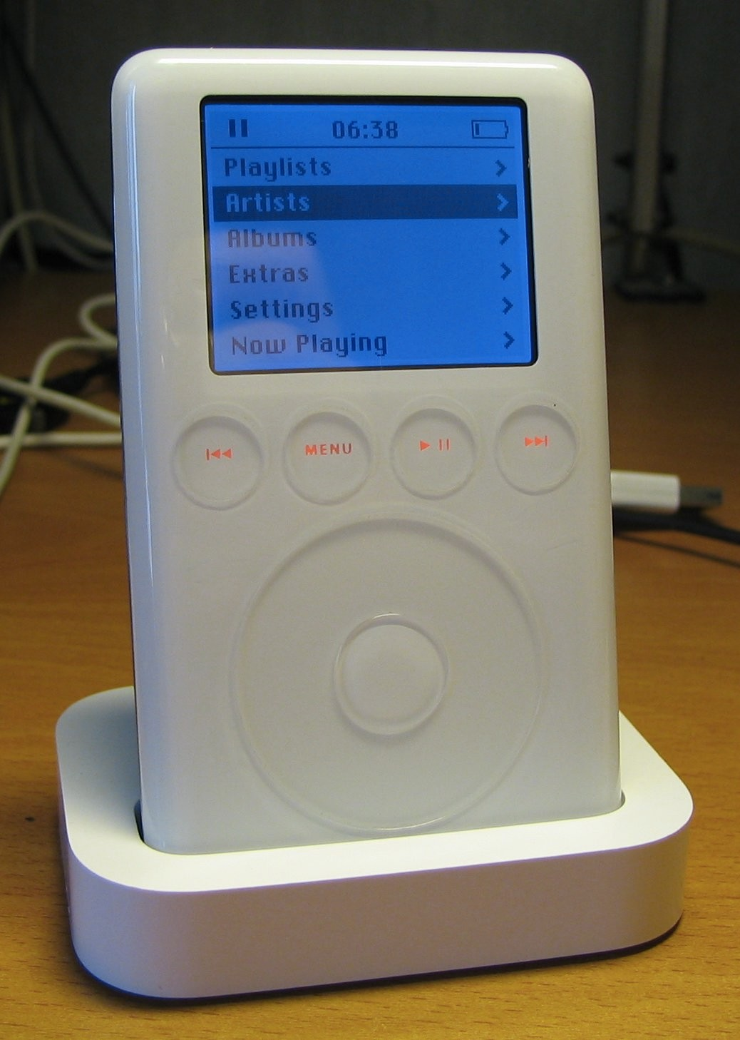

McKinsey Report (2013)

Slide 7

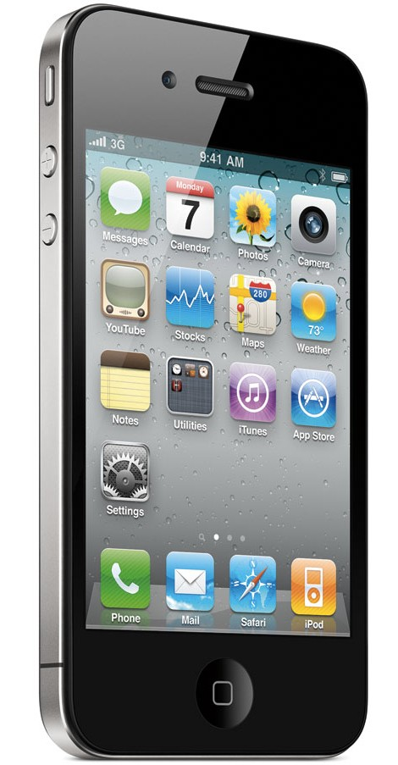
McKinsey Report (2013)

Slide 8



McKinsey Report (2013)

Slide 9

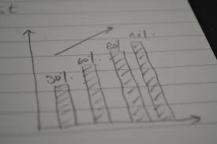
McKinsey Report (2013)

Slide 10
Data Science →→
#1 Catalyst for economic growth!
-McKinsey

Slide 11

Data Science →→
Cloud Computing
#1 Catalyst for economic growth!
-McKinsey

Slide 12
Computing anywhere and anytime

Slide 13
Computing anywhere and anytime
On-Demand Computing

Slide 14
Computing anywhere and anytime
dynamic and scalable data analysis

Slide 15
Data Torrent
Computing Anytime, Anywhere
Big Data Era

Slide 16
Applications:
What makes Big Data valuable

Slide 17
After this Part you will be able to..
Describe examples from fields where big data has enabled better models which allows for higher precision recommendations or solutions to make the world a better place

Slide 18
What Makes Big Data Valuable?
Big Data
Better Models Higher Precision

Slide 19



What Makes Big Data Valuable?
Big Data
Personalized marketing data
Happy customers!
Awesome!
Just what I was looking for!

Slide 20











What Makes Big Data Valuable?
I like blue plates!
×
I like gold plates!

Slide 21

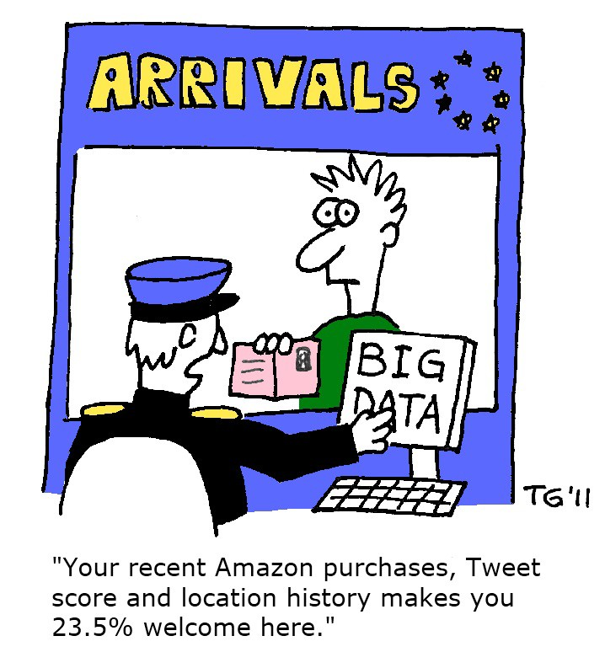
Personalized Marketing

Slide 22
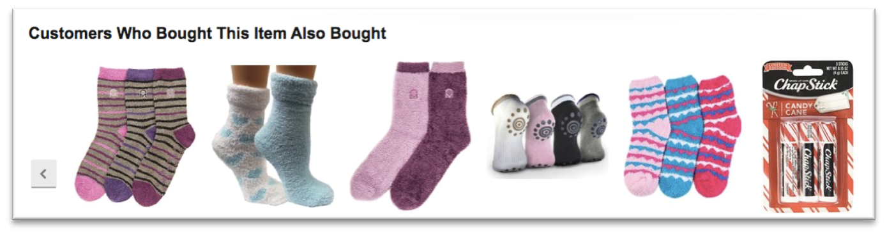


Recommendation Engines

Slide 23
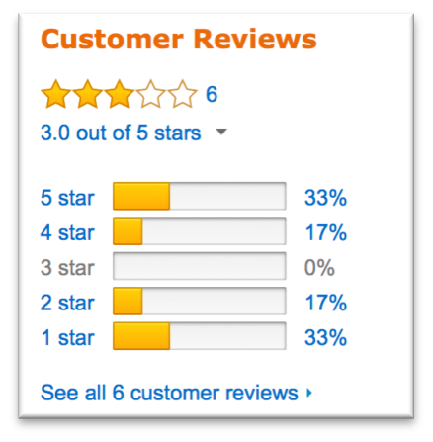


Sentiment Analysis
I love my new blue plates!
Let me write a review.

Slide 24
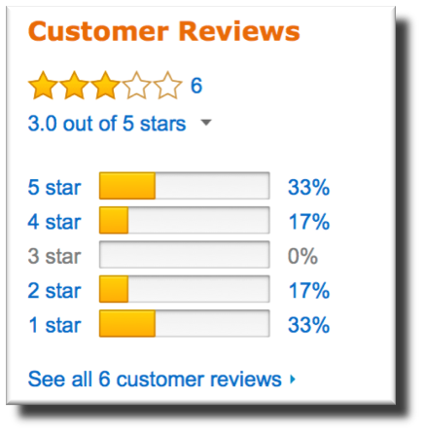



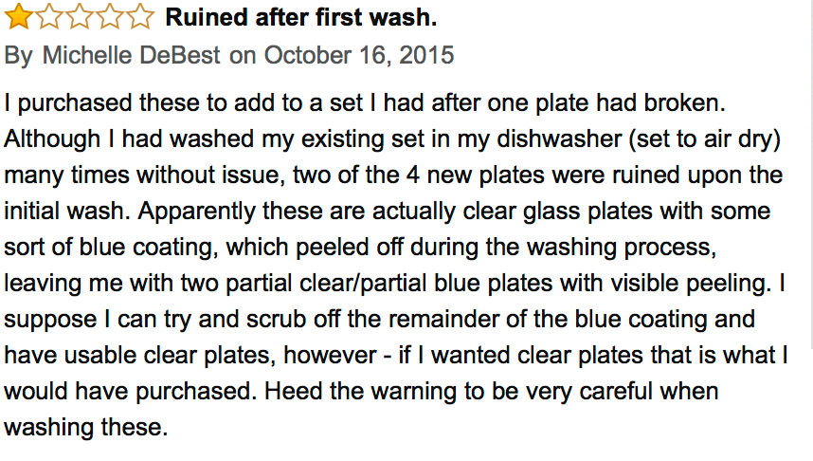
Sentiment Analysis
I love my new blue plates!
Let me write a review.

Slide 25



Sentiment Analysis
I love my new blue plates!
Let me write a review.

Slide 26

Sentiment Analysis
I love my new blue plates!
Let me write a review.
Natural Language Processing

Slide 27
Mobile Advertising

Slide 28



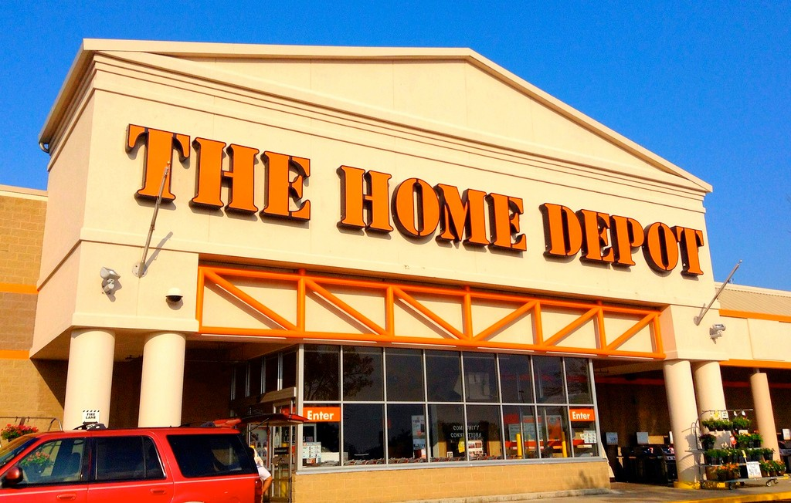




Mobile Advertising

Slide 29

Mobile Advertising
Paint on sale at Home Depot!

Slide 30


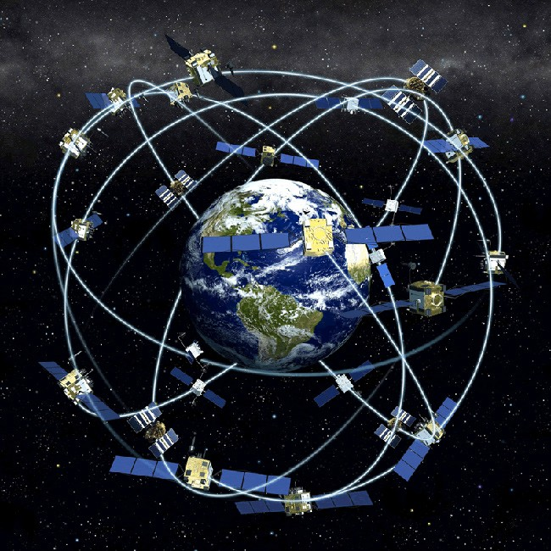
Mobile Advertising
Geolocation data
Customer profile Recent purchases

Slide 31
Consumer Growth to Guide Product Growth

Slide 32



Consumer Growth to Guide Product Growth
Collective Consumer Behavior

Slide 33

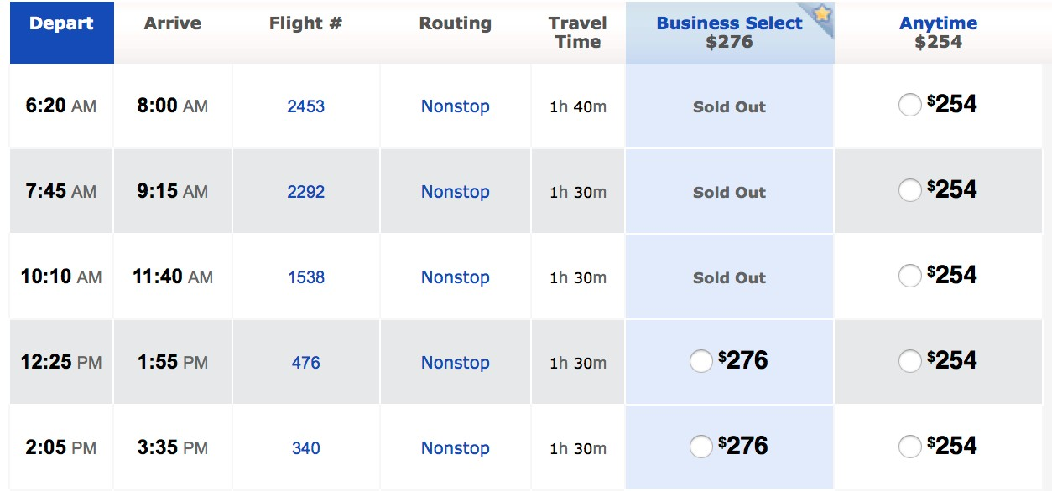
Consumer Growth to Guide Product Growth
Flight Schedule
We like morning flights!

Slide 34
Biomedical Applications

Slide 35
Biomedical Applications
2 billion human genomes sequenced by 2025

Slide 36
Biomedical Applications
2 billion human genomes sequenced by 2025
Up to 40 exabytes in storage!

Slide 37
Biomedical Applications
2 billion human genomes sequenced by 2025
Up to 40 exabytes in storage!
Up to 10,000 trillion CPU hours for processing!

Slide 38
Personalized Cancer Treatment
Common treatment

Slide 39
Personalized Cancer Treatment
Perform large scale analysis of patient genes and tumor growth
Customized treatment

Slide 40

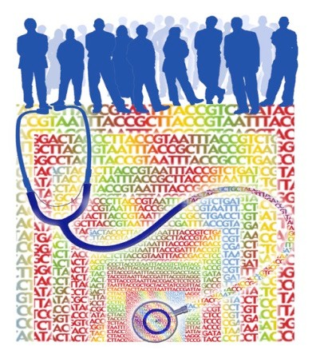


The Biomedical Big Data Challenge
How to integrate sources to gain further insight

Slide 41
Big Data-Driven Cities

Slide 42
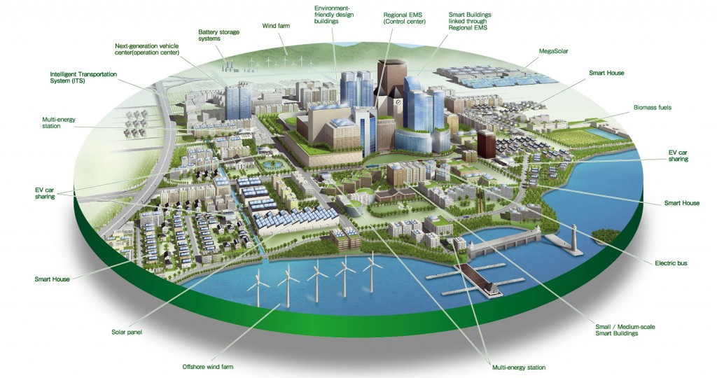
Smart Cities
Use city wide sensor data to
Lower energy costs, pollution
Improve services, traffic, safety, …

Slide 43
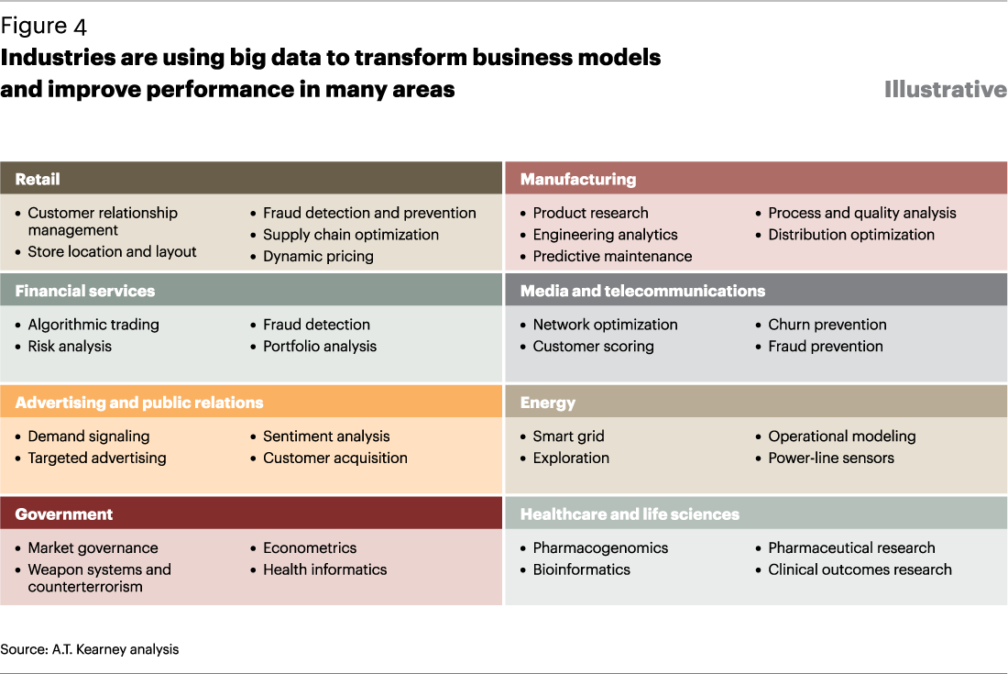
How are other applications using Big Data?

Slide 44
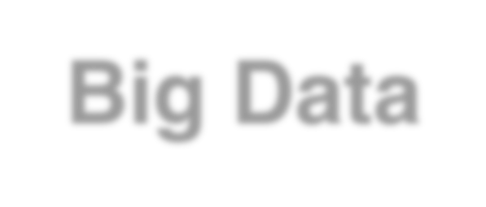







Smart and personalized business!
Big Data
Personalized Marketing Personalized Medicine Smart Cities
< and more! >
Better Models
Higher Precision

Slide 45
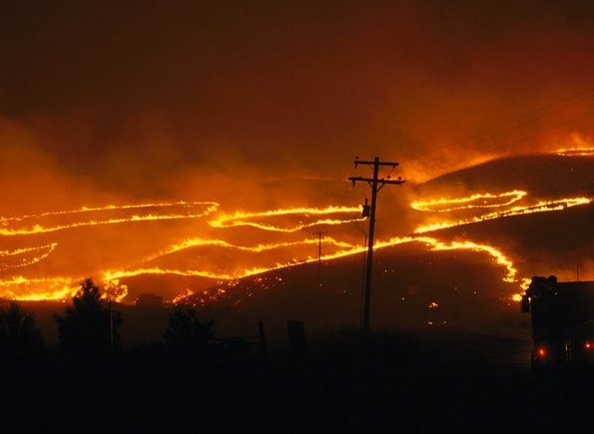
Saving Lives with Big Data:
Wildfire Prediction and Emergency Response

Slide 46
After this Part you will be able to..
Give an example of sensor, organizational, and people-generated data used in wildfire analytics
Explain to a friend why the integration of unexpected streams of data is critical to wildfire prevention and emergency response

Slide 47
Why important?

Slide 48
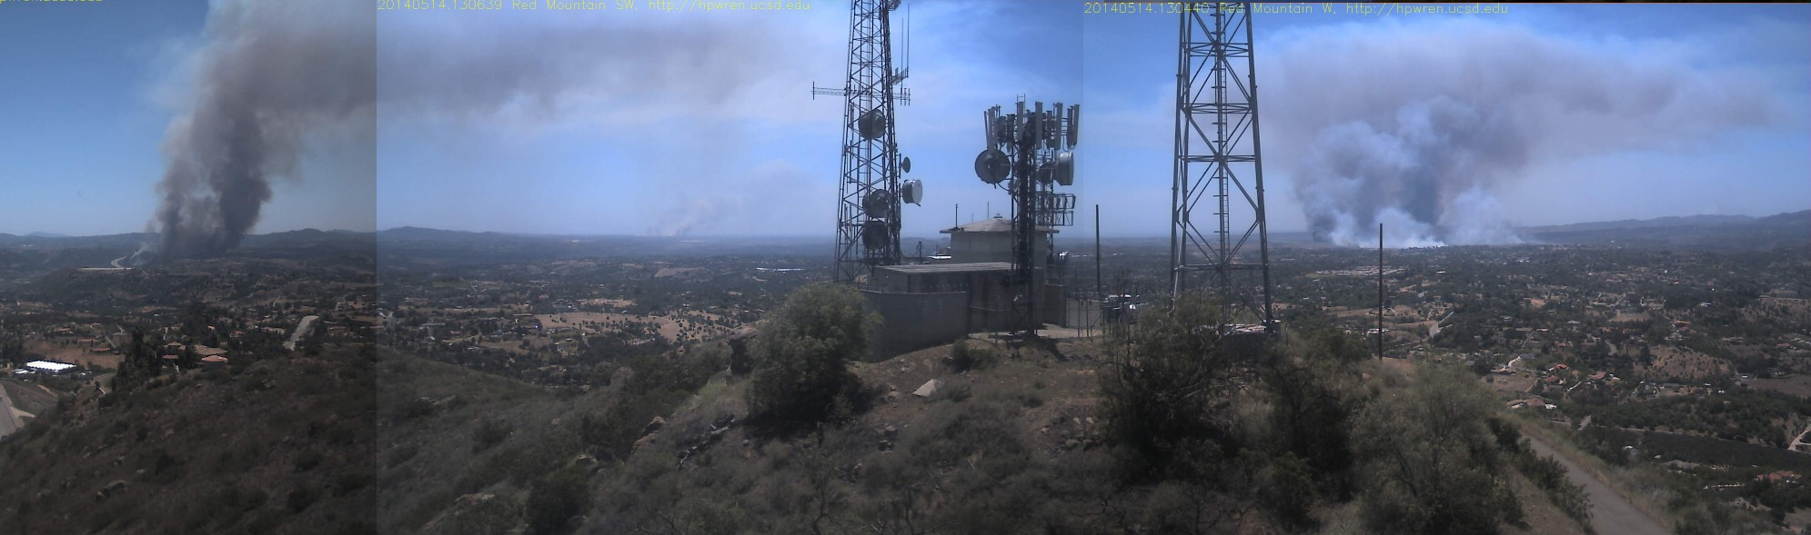
Why important?
San Diego County, May 14, 2014
14 fires burning

Slide 49
Why important?
San Diego County, May 14, 2014
14 fires burning
area of San Francisco

Slide 50
Why important?
San Diego County, May 14, 2014
14 fires burning
area of San Francisco
6 injured
+ 1 death

Slide 51
Why important?
San Diego County, May 14, 2014
14 fires burning
area of San Francisco
6 injured
+ 1 death
$60 million USD

Slide 52
Why can Big Data help?
People
Sensors
Organizations

Slide 53
Why can Big Data help?
_{ople} Sens
Integration of diverse data
ors
Pe
Organizations

Slide 54
Integration of diverse streams
see new things develop predictive analytics

Slide 55
Diverse Data Sources

Slide 56
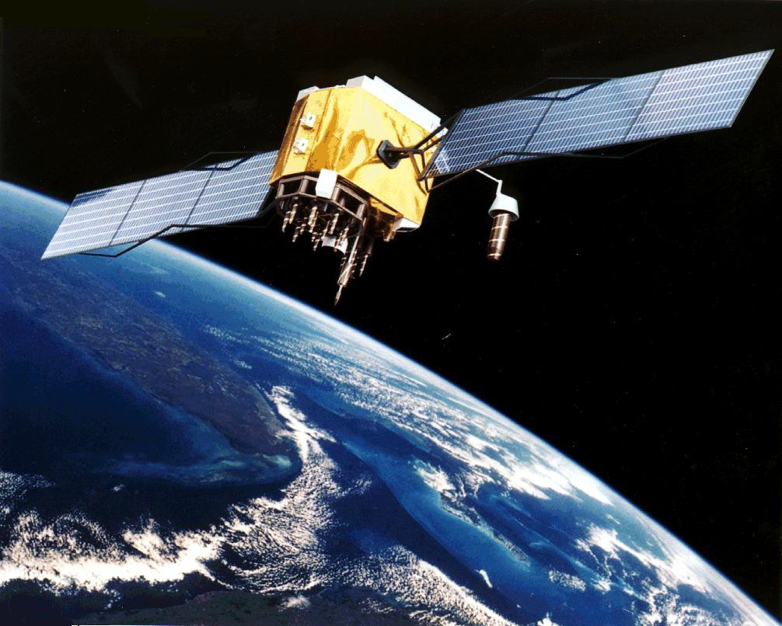
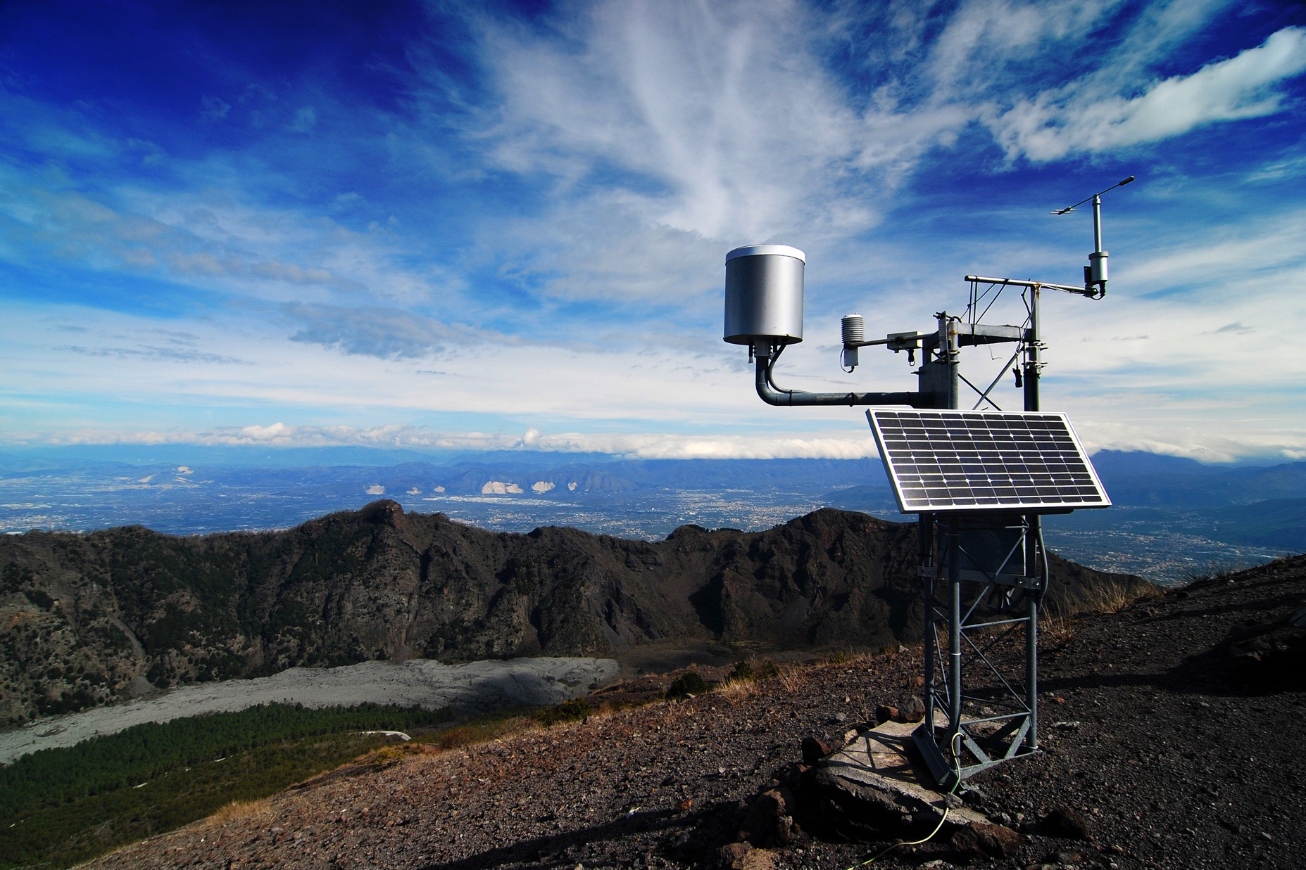
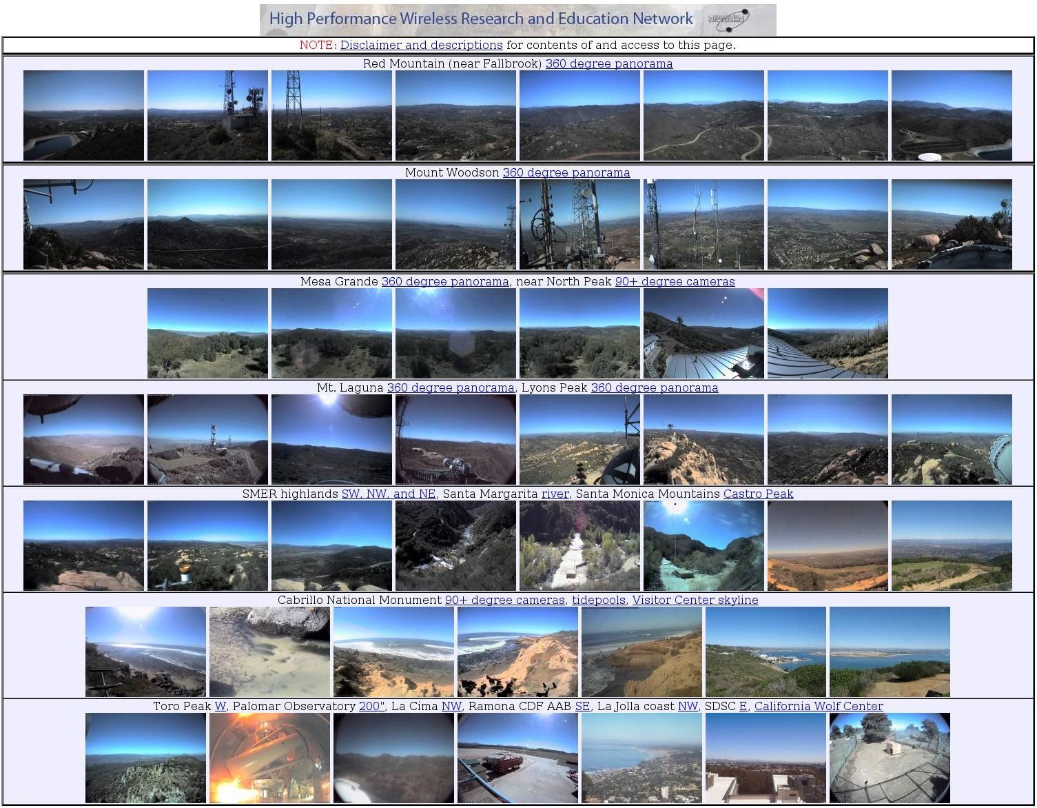
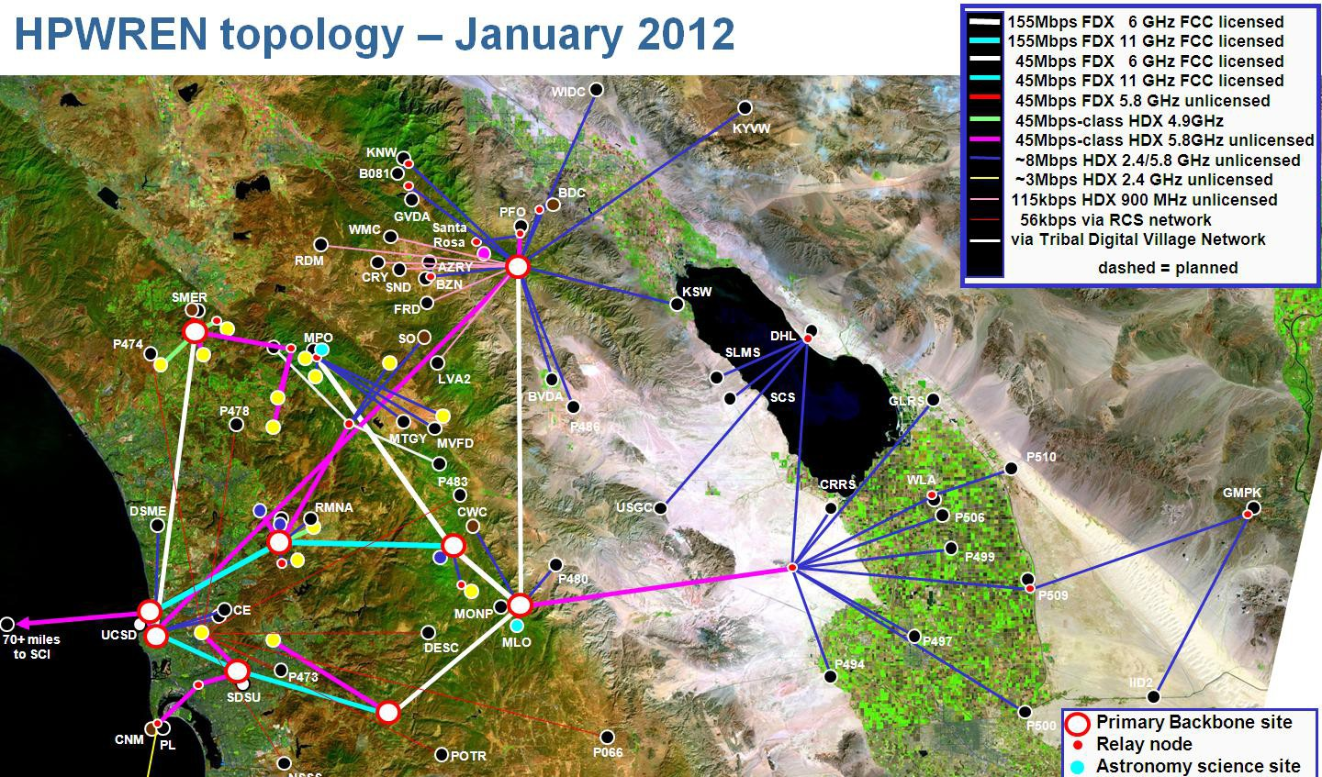
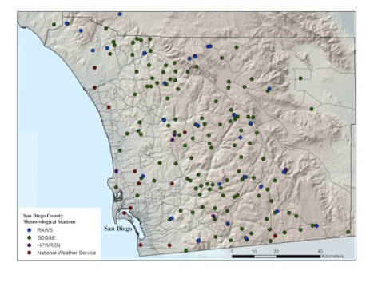
Machine Data

Slide 57
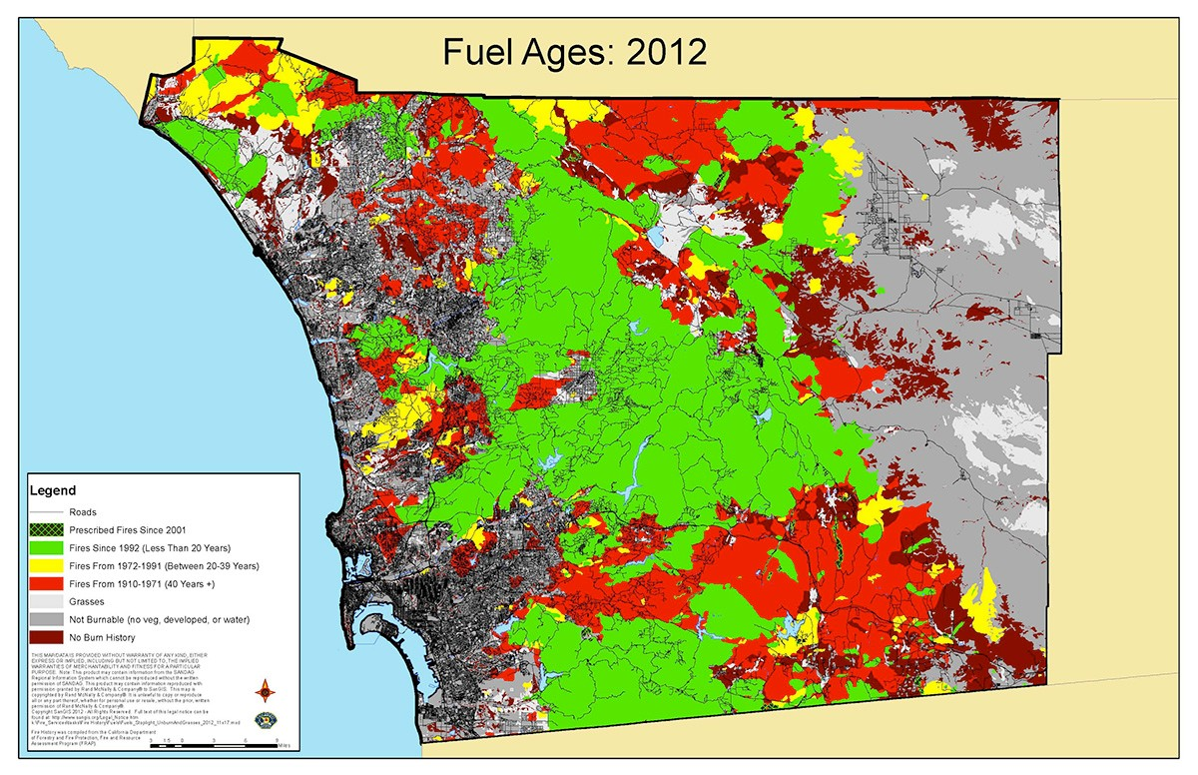
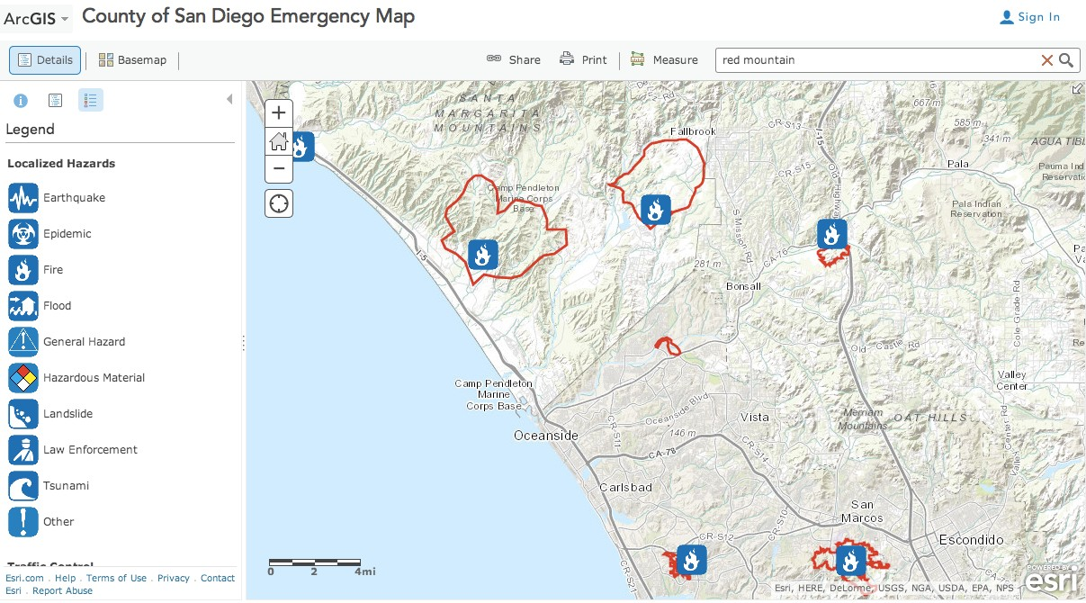
Organizational Data
San Diego County Emergency Map displaying fire perimeter
information from NICS.

Slide 58
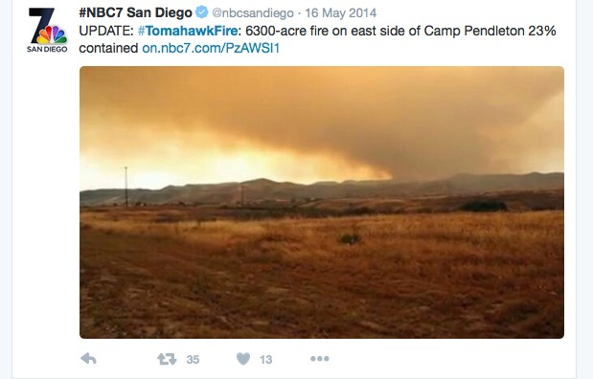
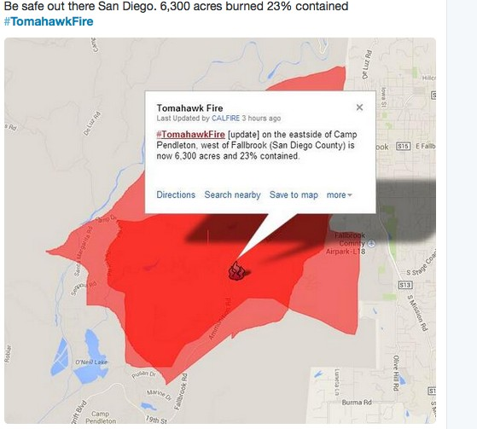
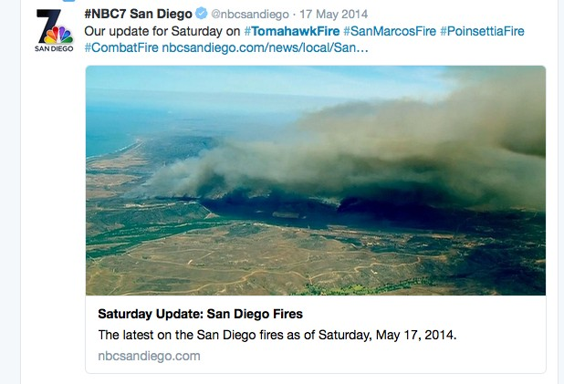
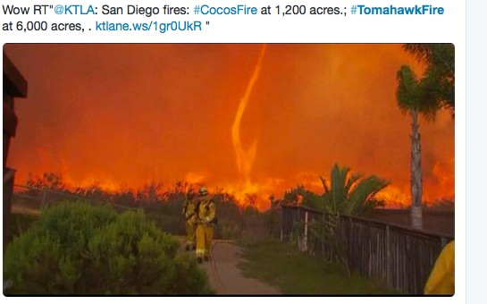
People

Slide 59

Monitoring
Big Data
Visualization Fire Modeling

Slide 60
Monitoring
Big Data
Visualization
Fire Modeling

Slide 61
Monitoring Visualization
Big Data
Fire Modeling

Slide 62
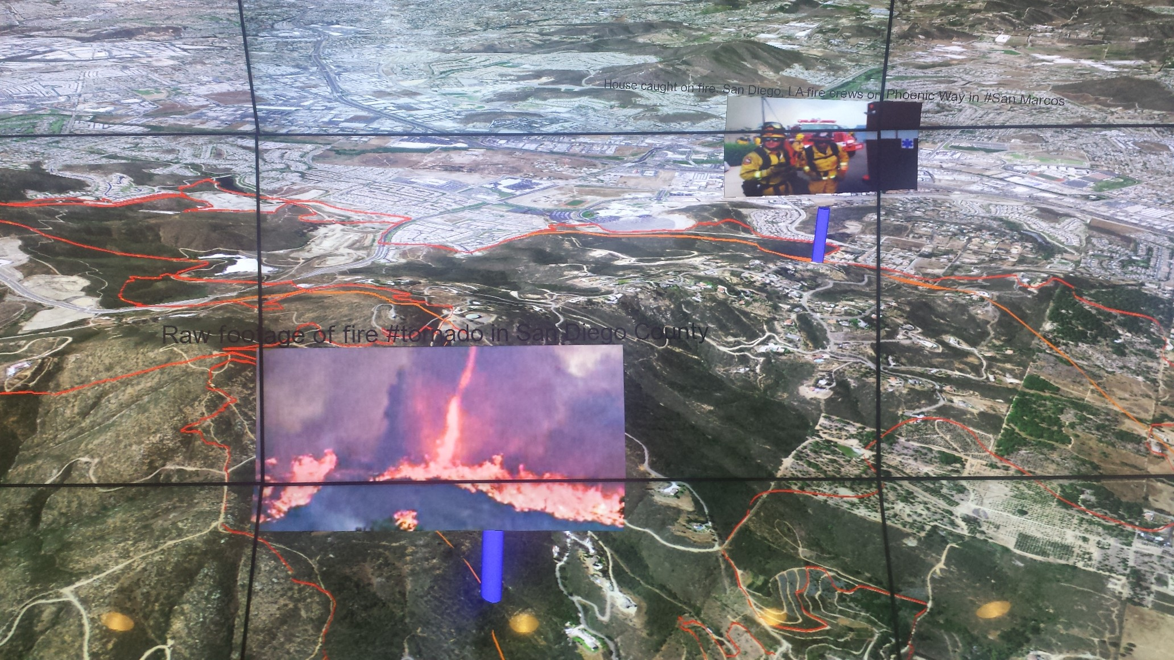
Wildfire Command Centers of the Future

Slide 63
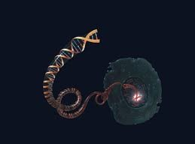
Saving Lives with Big Data: Precision Medicine and
Health Informatics

Slide 64
After this Part you will be able to..
Give examples of sensor, organizational, and people-generated data used in precision medicine
Explain to a friend why the integration of different streams of data is critical to advancing healthcare

Slide 65
Why is this important now?

Slide 66
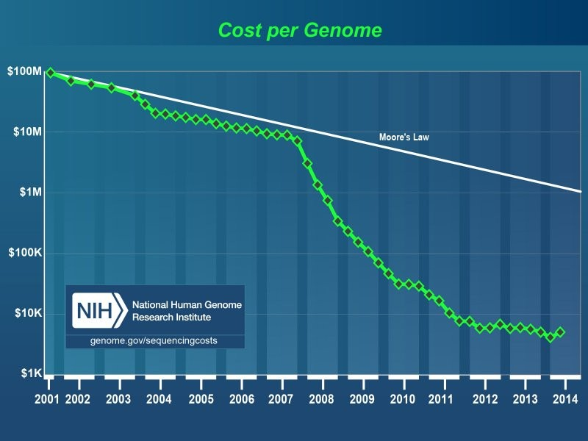
$100M
Moore’s law
Cost to sequence genome decreasing
$1M
$10K

Slide 67
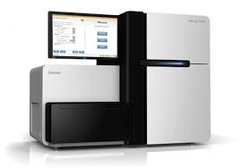
Genome Data Storage
700MB
AGTTA
200GB
1 day

Slide 68
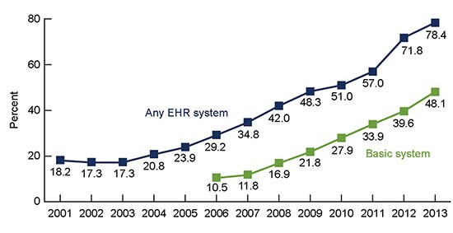
Health Records →→ Digital
Digital records
Paper records

Slide 69

120 Terabytes in 2013 2X more than in 2011

Slide 70
Recent changes →→ Big Data for Healthcare
Reduced Cost Analysis Cheap, Large Data Storage Digitization of Records

Slide 71
Why can Big Data help?
integration
People
Sensors
Organizations

Slide 72
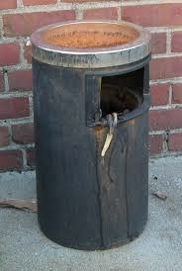
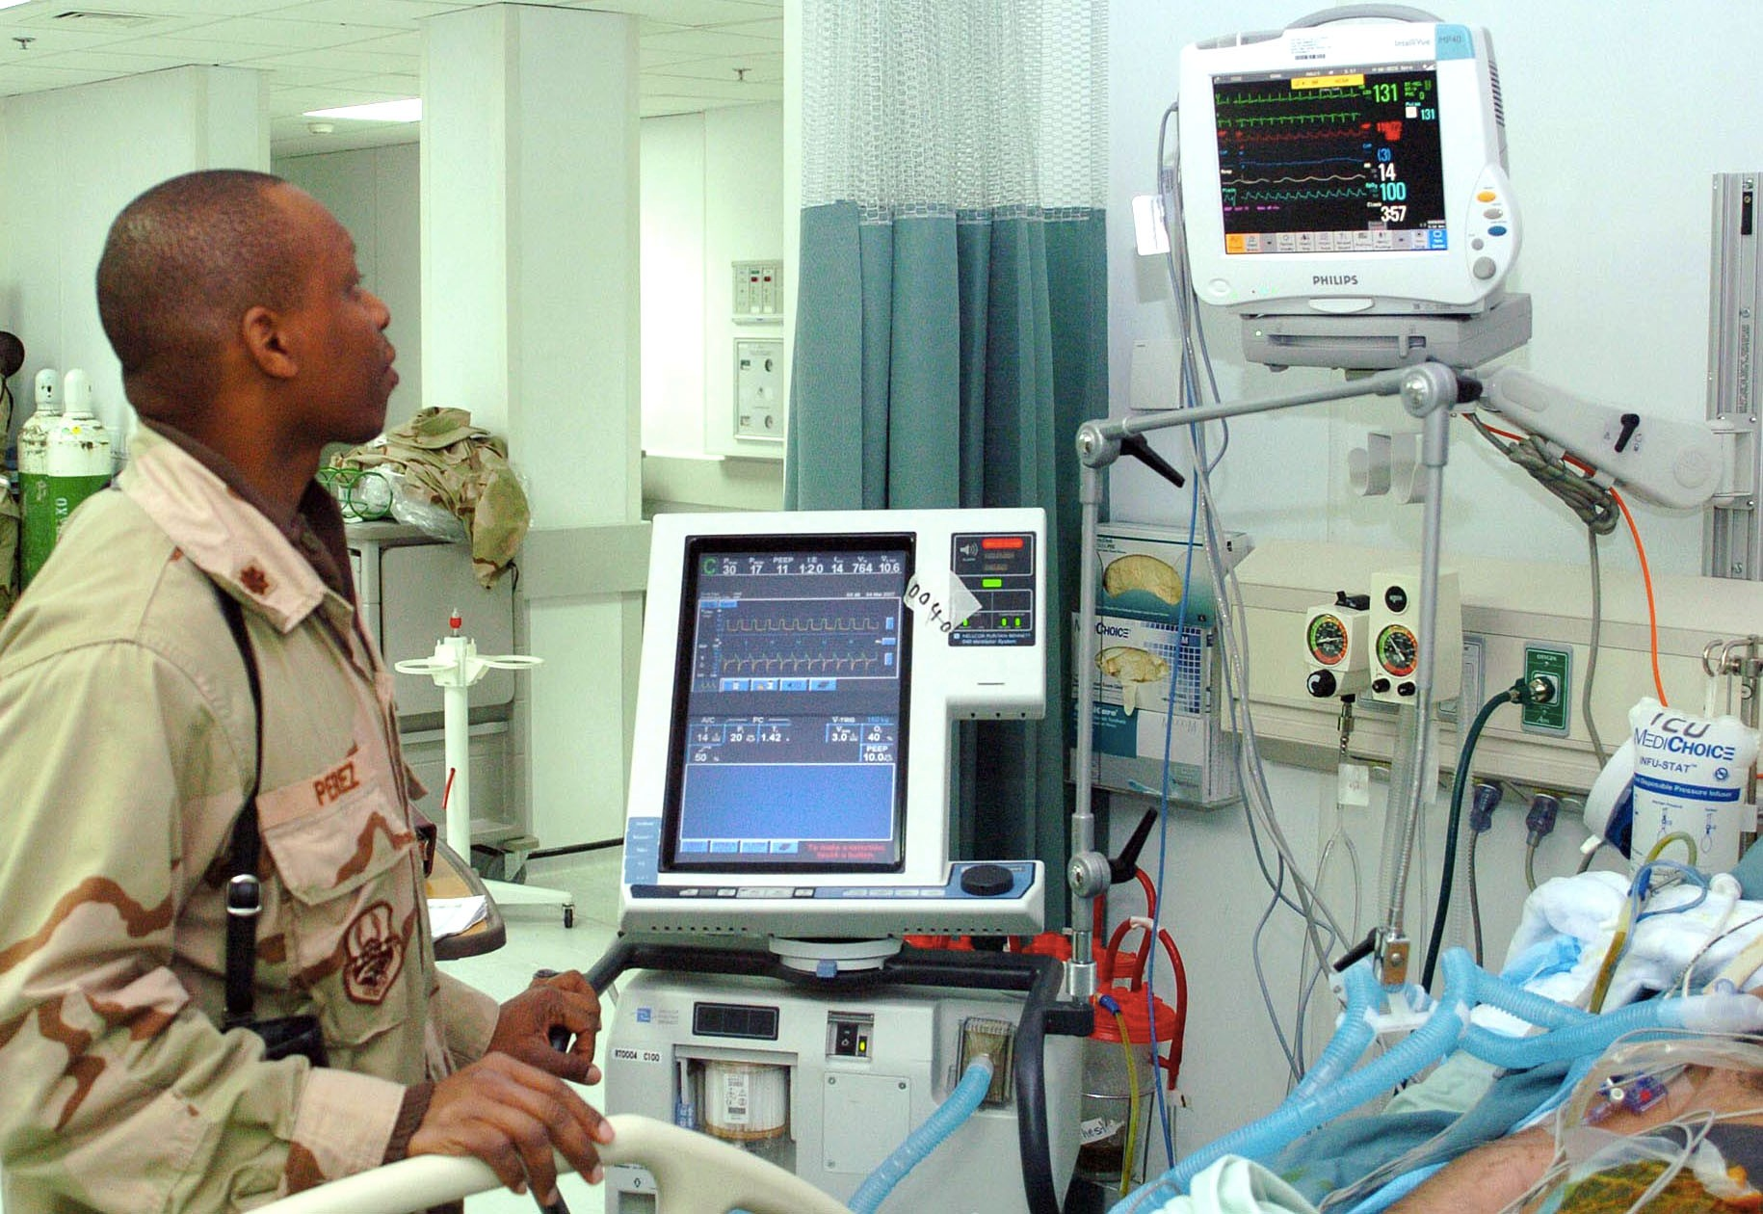
Sensor Data
101100010 →→

Slide 73
Sensor Data
More sensors, More places Data →→ Storage & Analysis

Slide 74
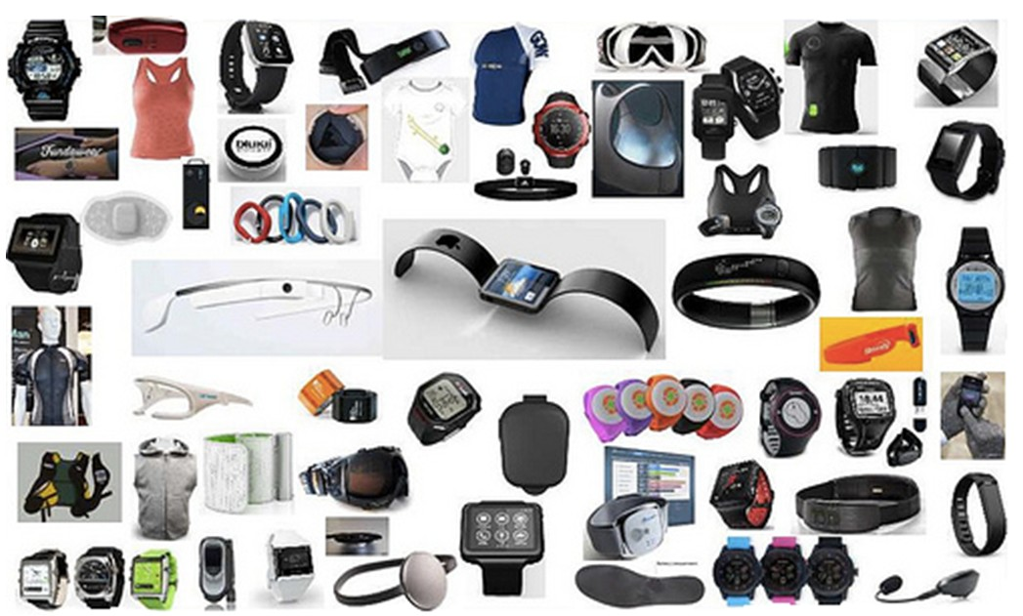
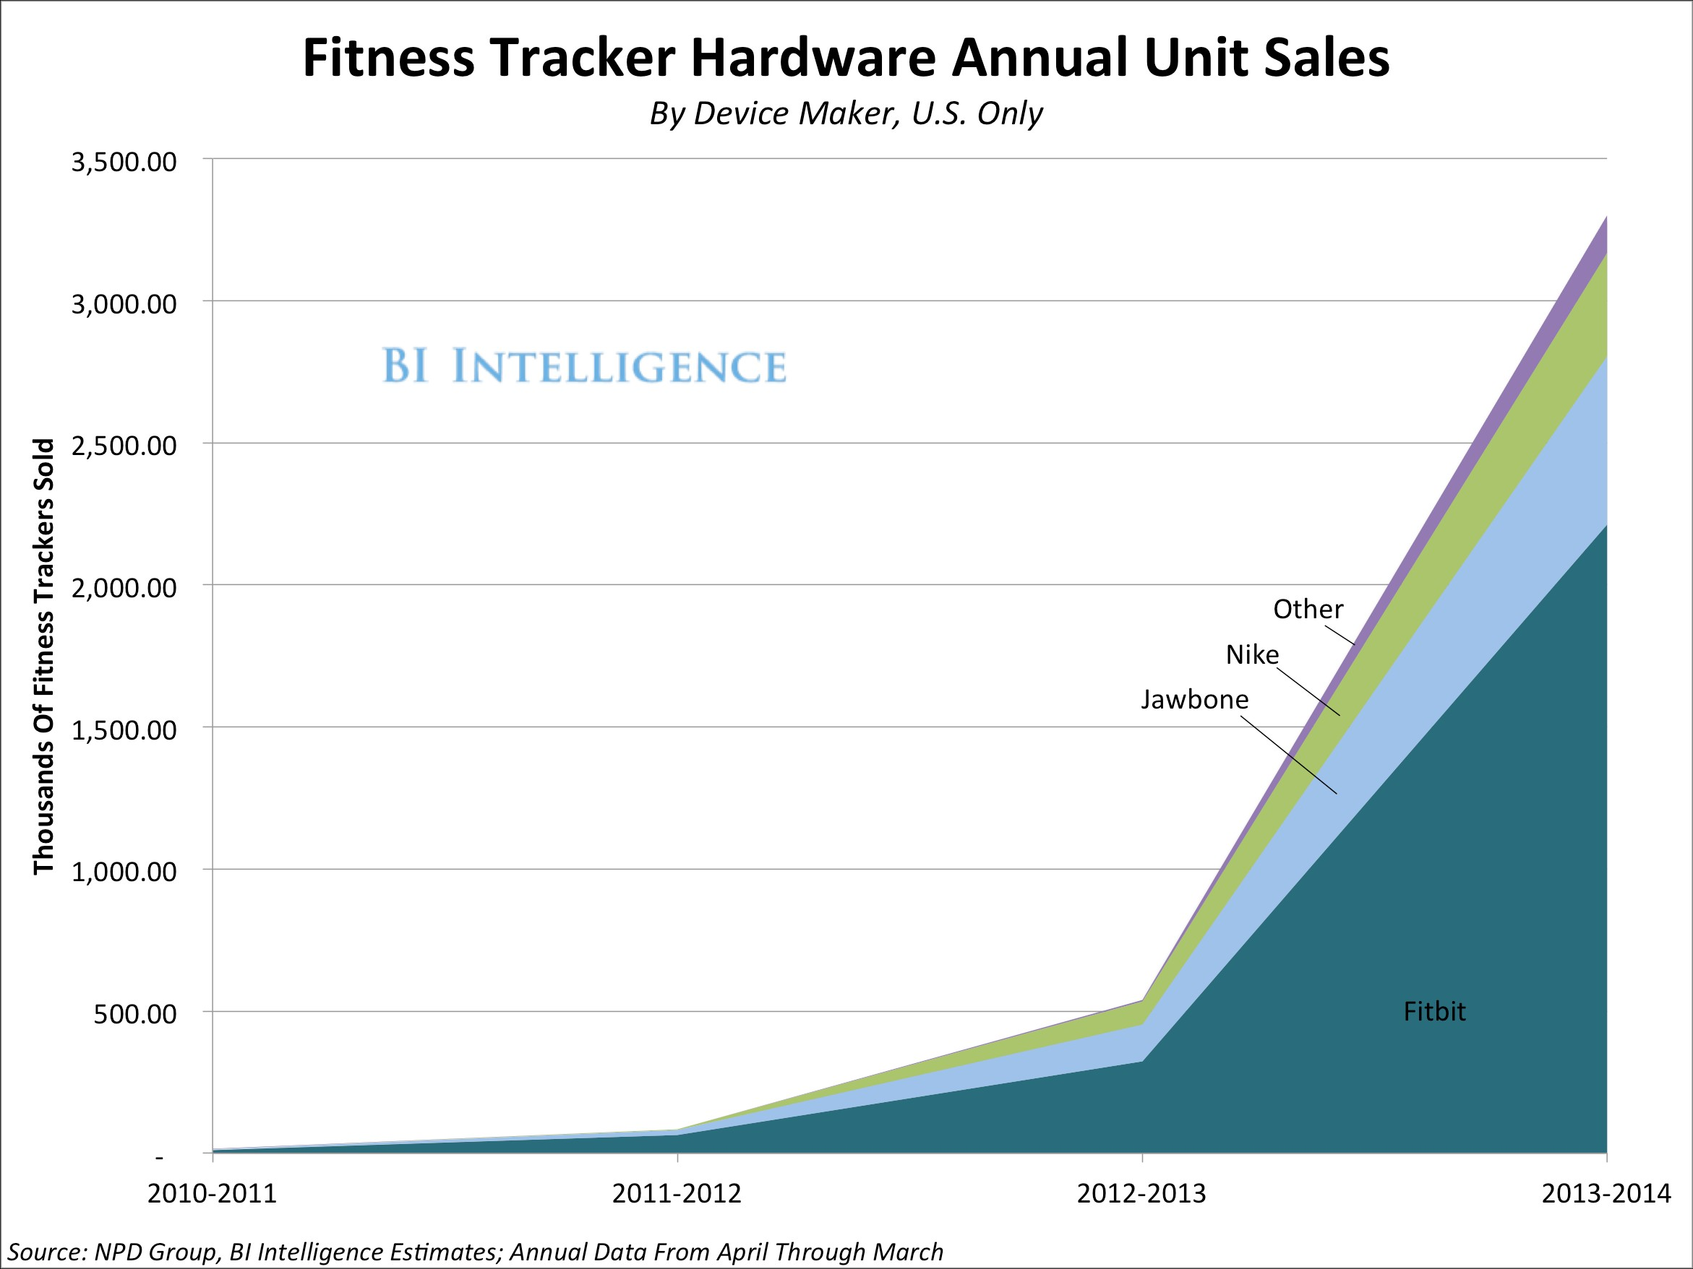
Fitness Device Industry
3.5M
Nike
Jawbone
0.5M
Fitbit
2014

Slide 75
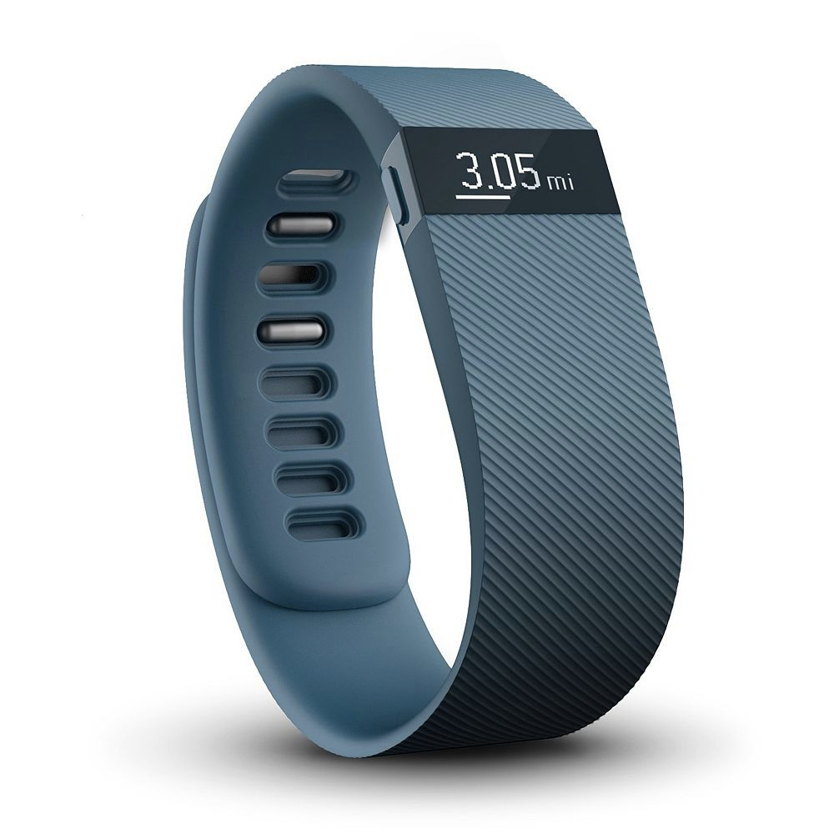
Data Generated?
2-5 GB / day

Slide 76


Save health care costs?

Slide 77
Organization Data

Slide 78
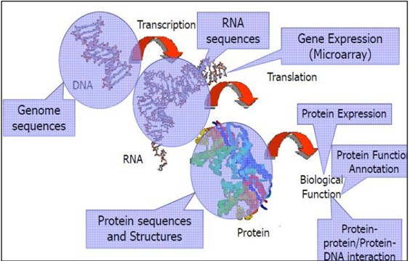
Scientific Data and Knowledge-bases
Experimental Data
Computed Data
National Center for Biotechnology Information

Slide 79


Scientific Data and Knowledge-bases

Slide 80
People Data

Slide 81

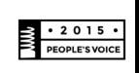
Mobile Health Apps
Webby
>100,000 health apps (iTunes & Google Play)
By 2017 →→
$26 billion market?

Slide 82

A story:
The impact of novel people-generated data
Have you had any reactions to
your medications?
It’s been a month… Was that a reaction?

Slide 83


Today →→ Self-Reported Data Social Media

Slide 84
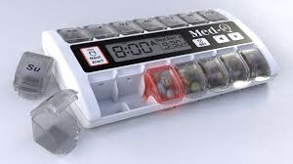

Integration →→ Personalization →→ Precision

Slide 85
integration
People
Sensors
Organizations
Integration →→ Personalization →→ Precision

